Slide 1
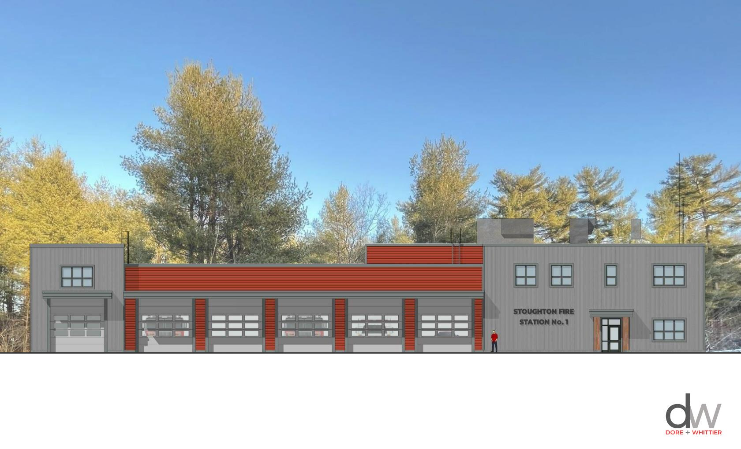
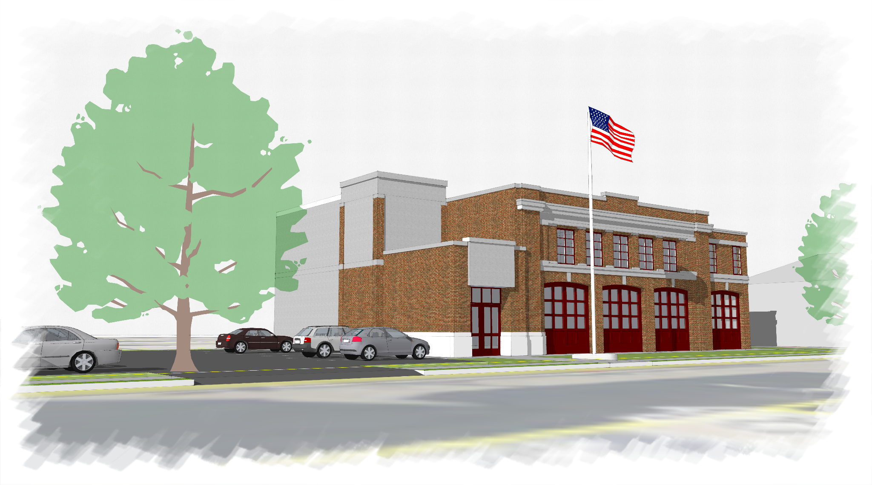
STOUGHTON FIRE STATION PROJECT
PUBLIC
INFORMATION MEETING
400 Prospect Street - Stoughton Fire Station #1
30 Freeman St – Headquarters and Emergency Operations and Public Health Center
March 20, 2023

Slide 2
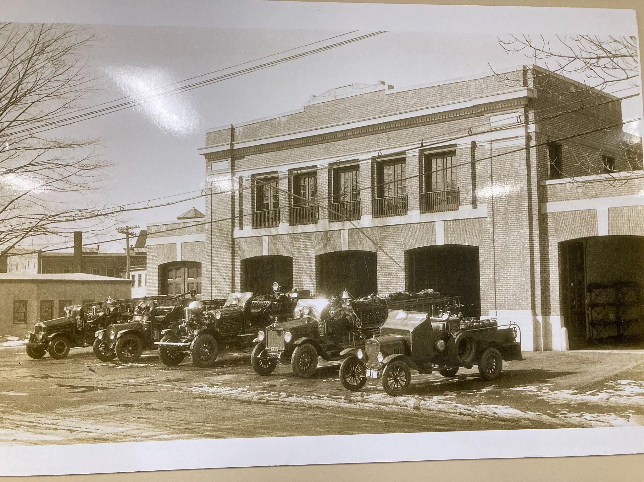
TOWN MANAGER - Tom Calter
INTRODUCTION
Public Information Sessions
Presentation of Facts
Response to Questions
Respectful Dialogue
Unlimited Time
Repeat if Needed

Slide 3
FIRE CHIEF - History
Freeman Street Station 1
1925- Town Meeting approved to build fire station and move from Town Hall
1927- Freeman St Station operational
1967- Town Meeting approves Fire Station Committee
1969- Town Meeting authorizes committee to enter into to contracts to reconstruct
fire station and/or make extraordinary repairs
1970- Two bays added to Station. one for mechanic
1997- After death of Firefighter Victor Melendy, two studies indicate the need for
additional fire station to fit the emergency needs for the Town
2001- Construction and opening of Station on Central St.
2007- Feasibility Study by Maguire Group. Recommend of a 5 Bay Station in East
Stoughton and a 3 Bay Station in North Stoughton
2010- DRA Associates conduct Facility Master Plan. Freeman St Station a priority
2016- Town meeting approves Public Safety Committee
estimated cost too high, decide to focus on fire station
2018/Present- Feasibility Study (Chief Laracy Ret./ Chief Carroll)
Current 3 Station Model
400 Prospect St - New Modern Operations Only Facility
30 Freeman St - Renovated to house Administration and Emergency Operations Center
1550 Central St - Station 2 Renovation for Operational and Ambulance Space

Slide 4
Stoughton Fire Station
Feasibility Studies Through the Years
1969- Select Board Meeting Statement regarding a new fire station
No Further Action Taken
1996- MMA Report
No Further Action Taken
2007- Feasibility Study (Chief David Jardin Ret.)
No Further Action Taken
2014- Feasibility Study (Chief Mark Dolloff Ret.)
No Further Action Taken
2018/Present- Feasibility Study (Chief Laracy Ret./ Chief Carroll)
Current 3 Station Model
30 Freeman St - Renovated to house Administration and Emergency Operations Center
400 Prospect St - New Modern Operations Only Facility
1550 Central St - Station 2 Renovation for Operational and Ambulance Space

Slide 5
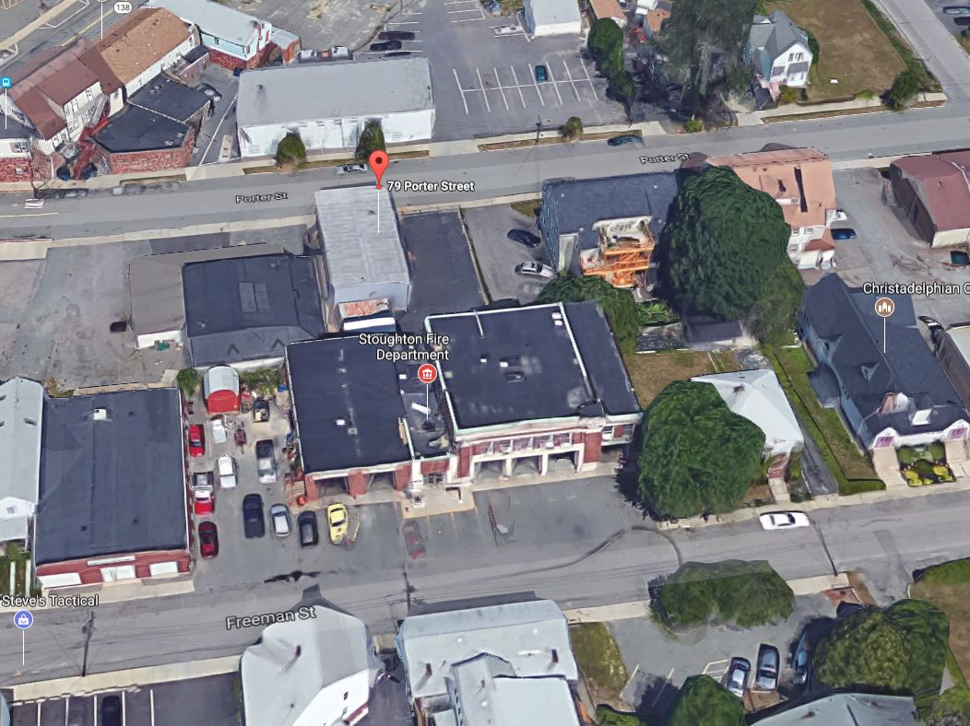
Stoughton Fire Station 1
Why?
Designed and Built for 1926 apparatus
-
No facilities for female firefighters
non-ADA Compliant
Response delayed at times while trying to go
through Center
https://youtu.be/1RpXG3w-iLU

Slide 6
Legal
Title
Eminent Domain
Access Easement
Working Group

Slide 7
PROCUREMENT AND RFP
1st RFP – Site Selection – Response due date April 30th, 2021
1 response – 850 Park Street $2,400,000.00
Assessed FY21 value $457,900.00
Proposal was withdrawn by owner June 5, 2021

Slide 8
PROCUREMENT AND RFP
2nd RFP – Site Selection – Response due date July 30, 2021
400 Prospect Street
$1,150,000.00 - Assessed FY22 value $829,800.00
850 Park Street (2 options)
$1,900,000.00 - Assessed value FY22 $489,900.00
$1,400,000.00 - carved out piece of property - carved out property is not separately assessed
Recommendation to move forwarded with 400 Prospect Street - lowest price

Slide 9
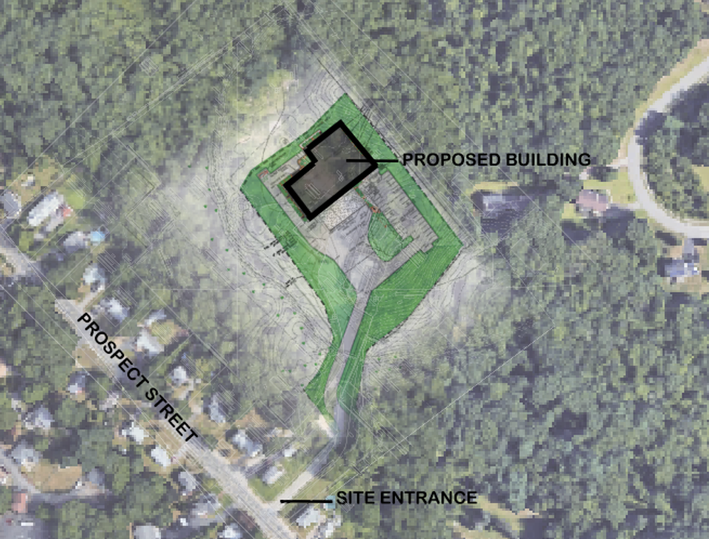
Site Assessment
SITE ASSESSMENT OUTLINE:
Initial Site Assessment
Wetland Delineation/ Existing Conditions Survey
21E Environmental Site Assessment
Geotechnical Investigation
Site Design/ Permitting
Traffic Mitigation (GPI)
Pest Control

Slide 10
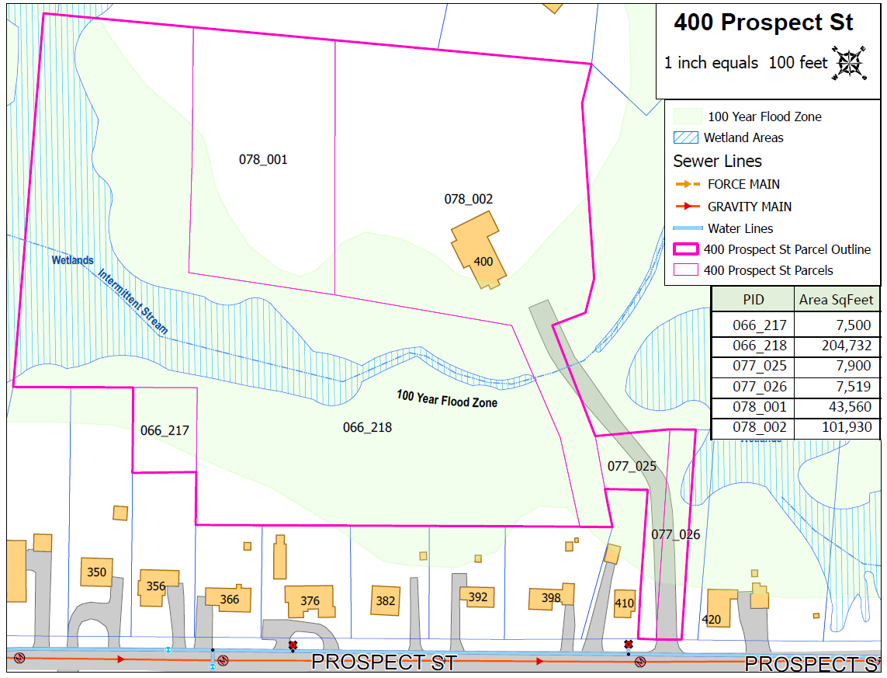
Initial Site Assessment
DIRECTIVE BY TOWN MANAGER:
Evaluate all properties submitted to RFP to ensure buildable portion would support :
bldg. footprint, parking, maneuver area, utilities and stormwater management areas
#400 Prospect Street:
6 Parcels (8.56 Total AC consists of: Upland, Wetlands, Woods, Brush, Pavement & Building)
Contiguous Upland Area = 5.3 AC (situated approx. 10’ higher in elevation than wetland)
Existing Impervious = 30,400 SF +/-
Wetland Resource Areas (Intermittent Stream, Bordering Vegetated Wetland & 100-YR Flood Plain)
Existing Stormwater Management (no existing BMPs, 48” RCP Culvert at driveway crossing)
Other Utilities are available to Service the Site (gas, OHE, sewer, water)

Slide 11
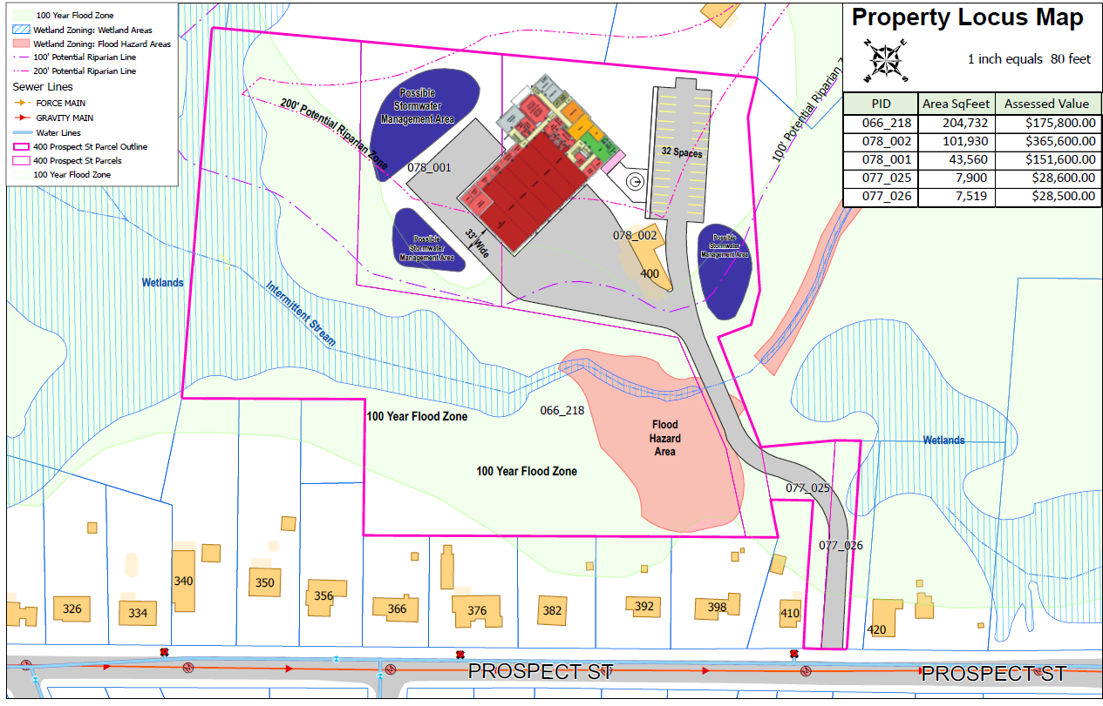
Initial Site Assessment - Preliminary Site Layout
PRELIMINARY BUILDING PROGRAM:
26,000+/- sf Building with dormitory area, 5 Truck Bays and 1 Service Bay
Sufficient area for vehicle maneuvering and easy departure from building
Adequate Site access/egress to Town Road network
32 Parking Spaces
Available area for stormwater management
Utilities available to service building needs (water, sewer, gas, electric)

Slide 12
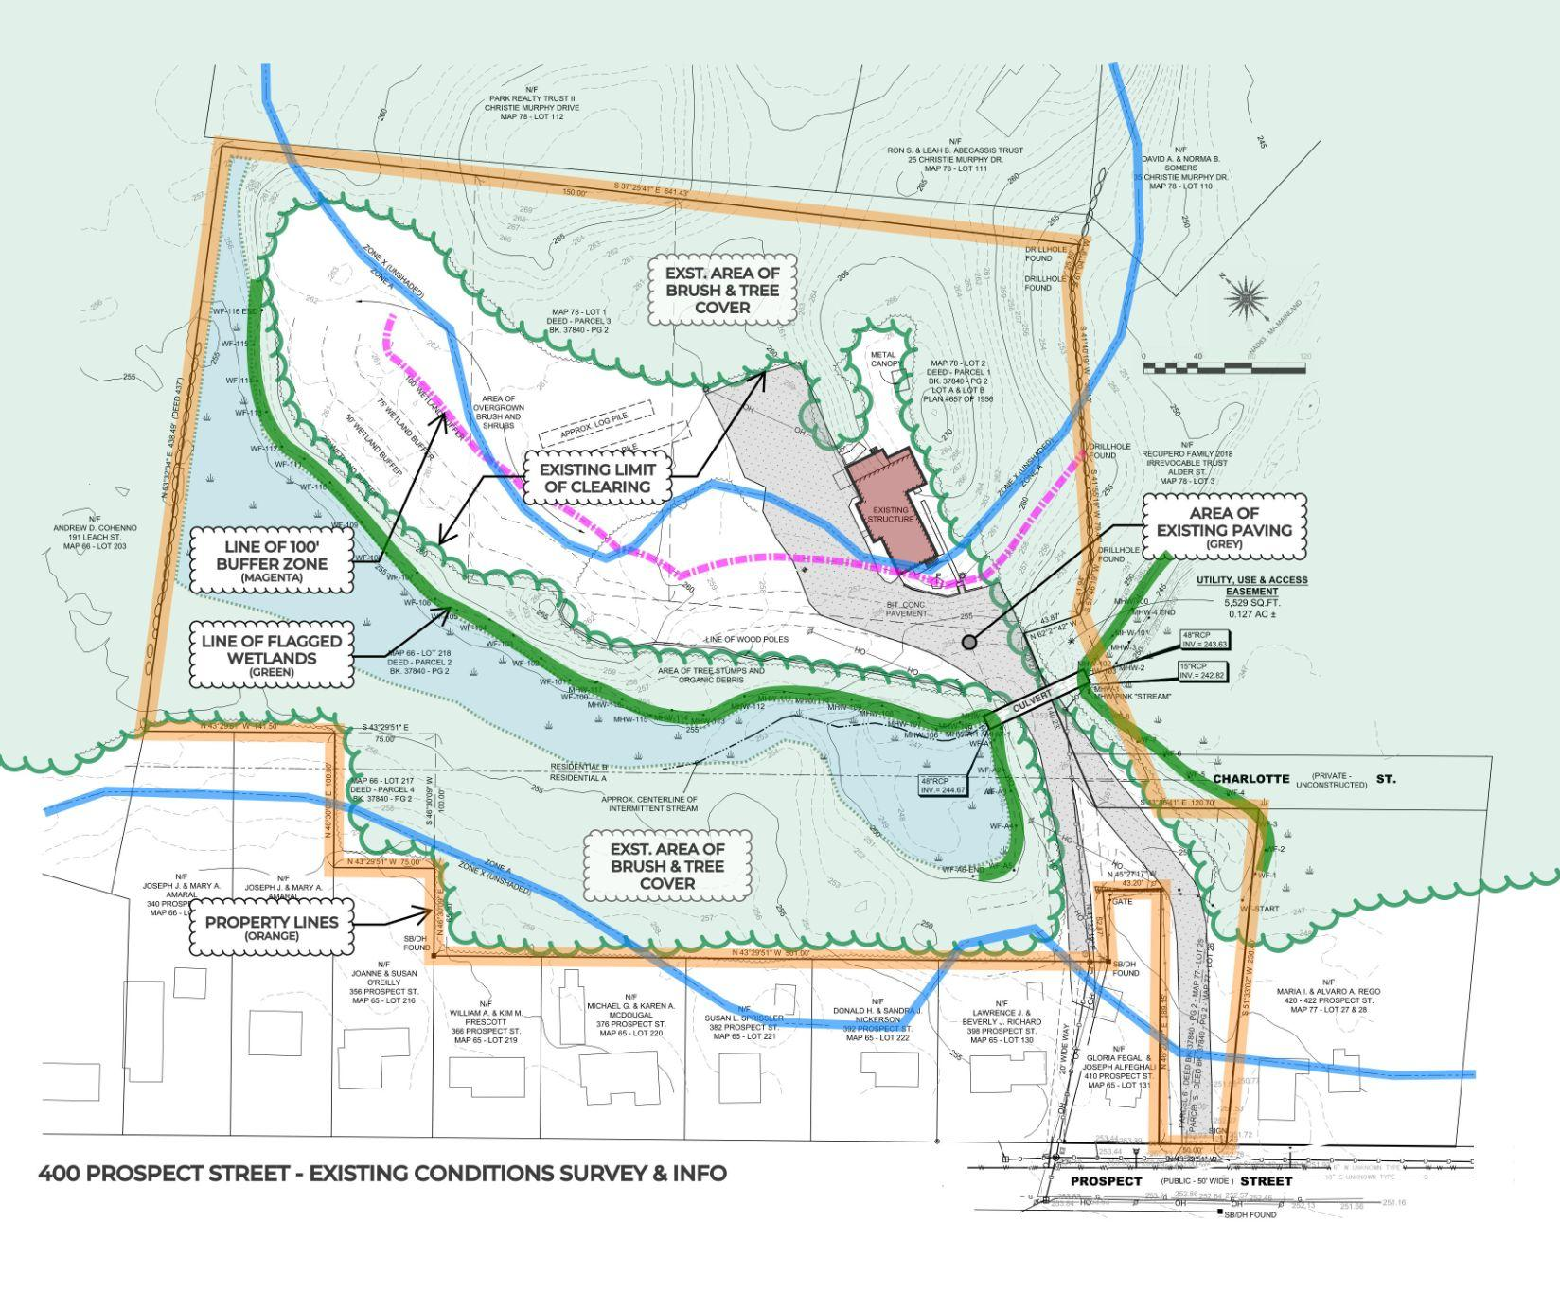
Wetland Delineation & Existing Conditions Survey
Existing Wetland Resource Areas were delineated by an Environmental Scientist, Pinebrook Consulting, on September 8, 2021 per DEP Regulations.
Soils (hydric soils)
Hydrology (connectivity)
Vegetation (wetland species)
A Topographic Survey of the subject property was performed by River Hawk Land Survey, LLC and an Existing Conditions Plan was generated showing:
property boundary
site features (buildings, pavement, tree lines, utilities, etc.)
wetland resource areas
confirms 10’+/- elevation difference between wetland and developed area

Slide 13
21E Environmental Site Assessment
River Hawk Environmental, LLC performed a 21E Phase 1 Environmental Site Assessment (ESA) & Phase 2 Limited Sub-surface Investigation (LSI) of the property in November of 2021
•Phase 1 ESA involved a search of available governmental, real estate, and commercial use records, which help identify potential or existing environmental contamination liabilities associated with the property. The Phase I ESA also involved an inspection of the property to visually observe and record any obvious environmental conditions that may exist in conformance with ASTM Policies and protocols set forth by the MassDEP.
•Phase 2 LSI excavated 11 Test Pits throughout the upland portions of the site and recorded field observations, and field screenings. Soil samples were collected and analyzed for contaminant concentrations as set forth in the Massachusetts Contingency Plan.
• The Phase 1 ESA identified a 500-gallon Underground Storage Tank on-site. The tank was intact and no leaks were identified. The Tank was removed as recommended.
•No other Recognized Environmental Conditions (RECs: the likely presence of any Hazardous substances or petroleum products) were found at the site.

Slide 14
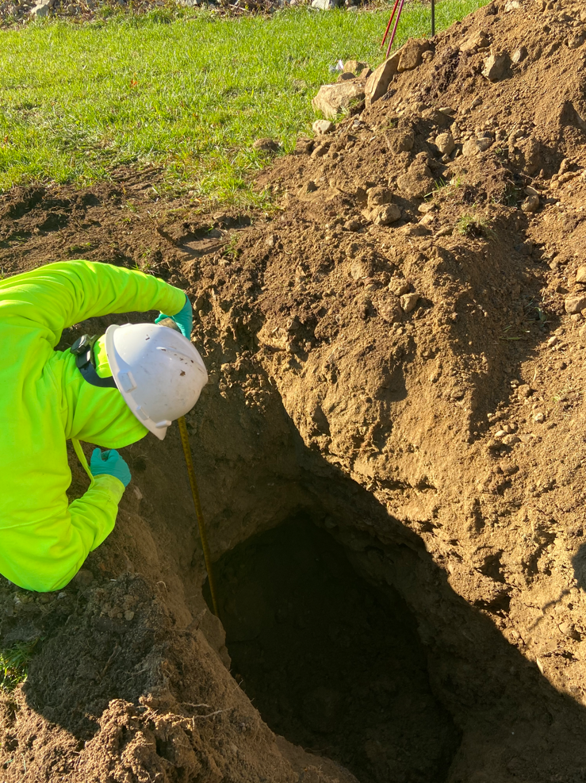
Geotechnical Investigation
Geotechnical Borings and Test Pits were performed by PES Associates in July of 2022 and a Geotechnical Report was generated. The Geotechnical Report determined an Allowable Bearing Pressure of the existing glacial till for construction of the building and site features.
Additional Test Pits were excavated by the site Civil Engineer, Nitsch Engineering, to determine Soil Texture and Groundwater Table Elevation for the design of the site Stormwater Management Areas in accordance with DEP Stormwater Management Guidelines.
In total, (2) Borings and (33) Test Pits have been performed on the Site.

Slide 15
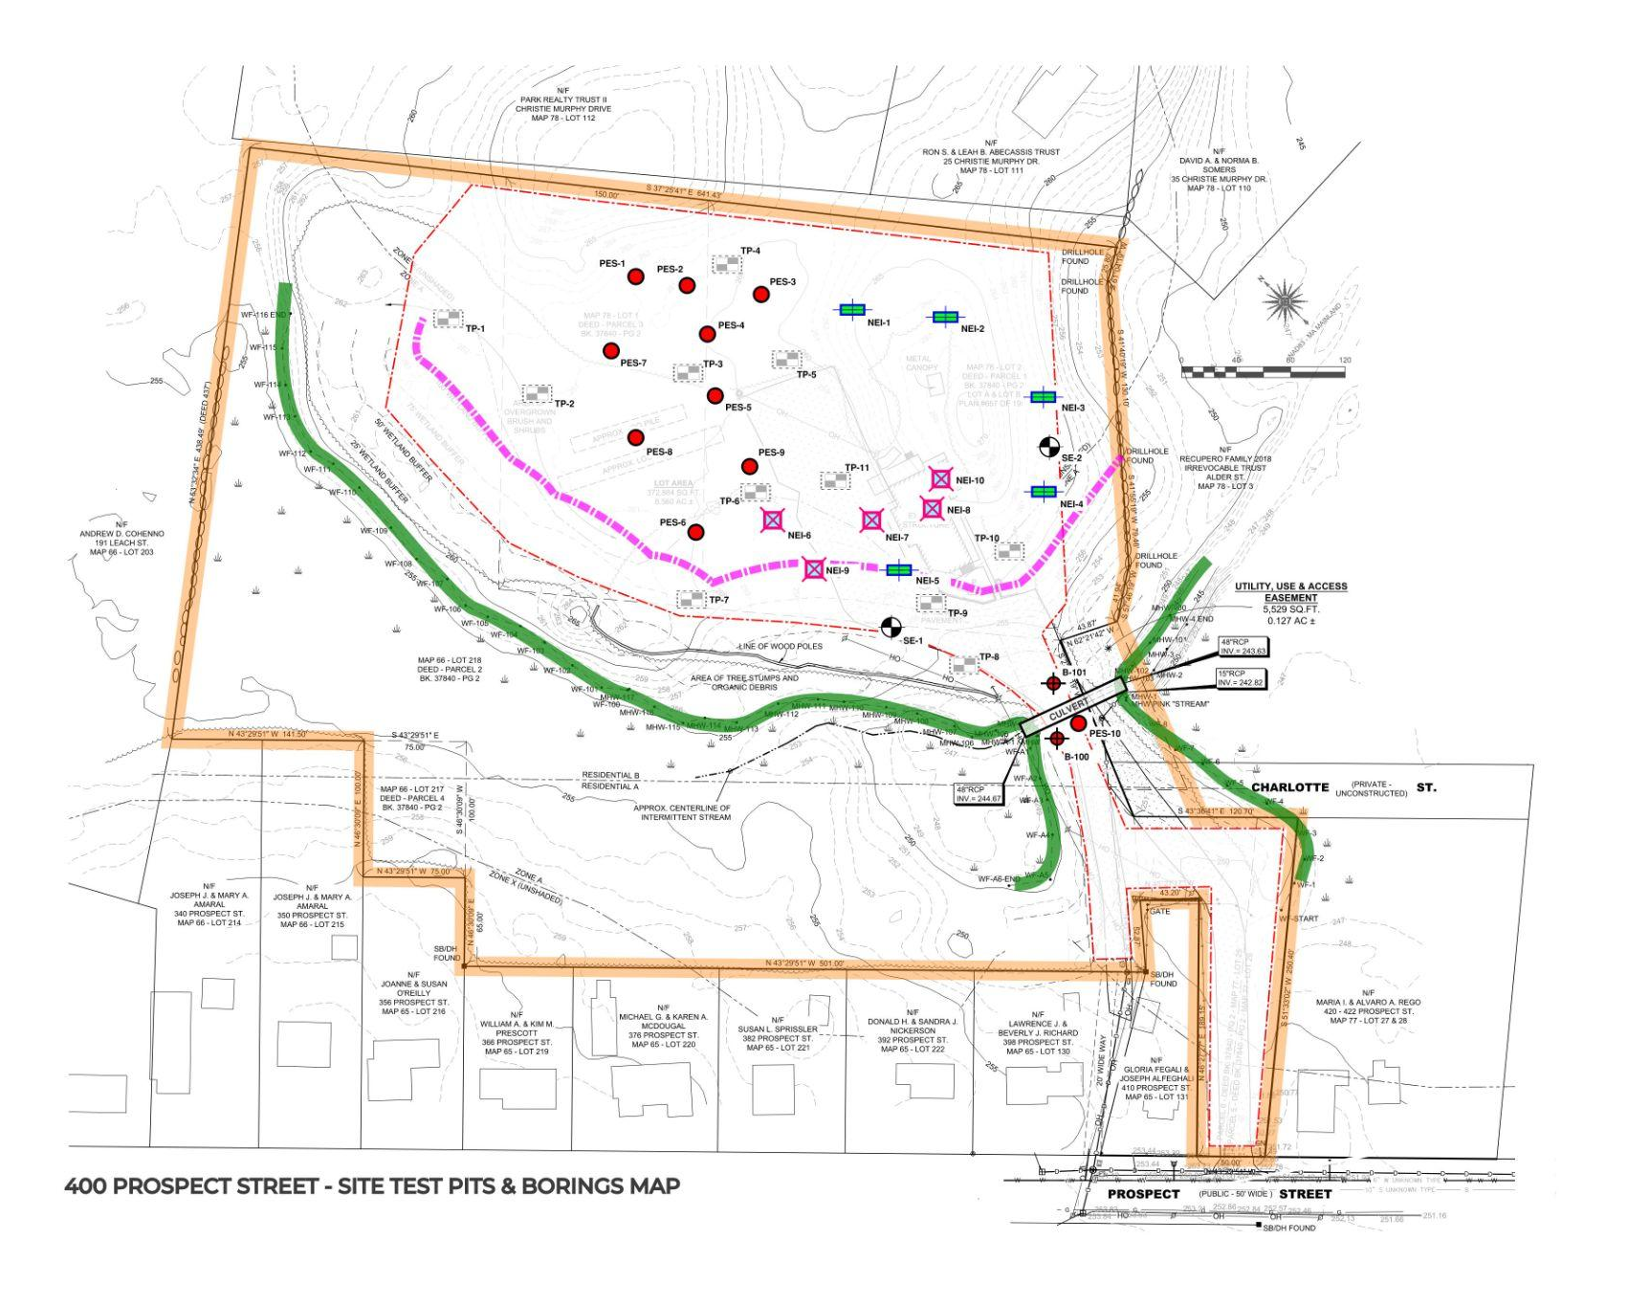
Soil Borings and Test Pit Plan

Slide 16
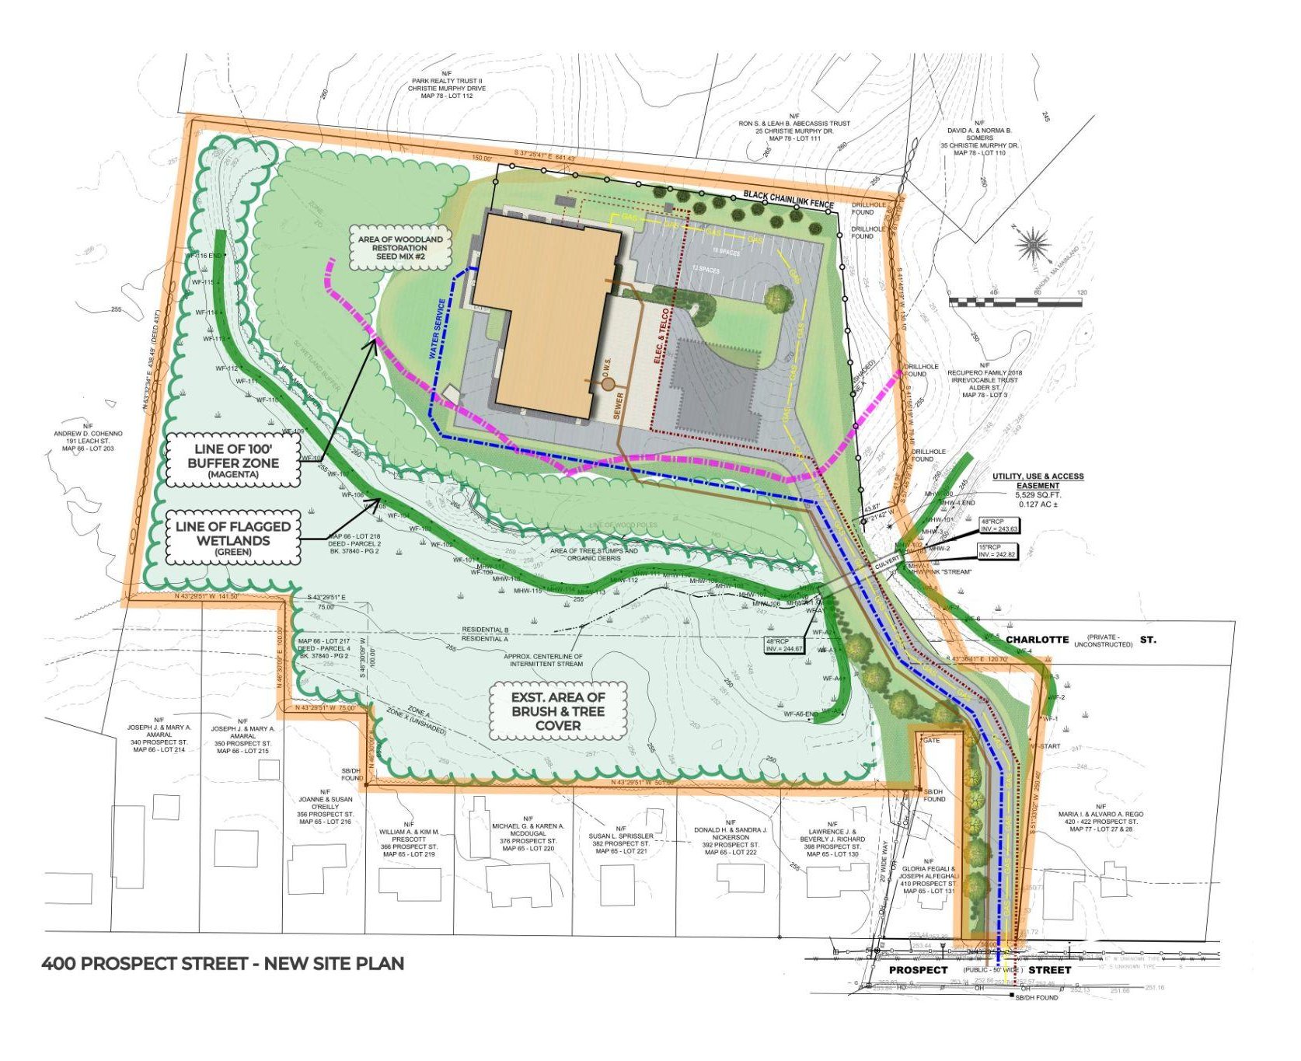
Site Design and Permitting
SITE DESIGN
Building, parking layout
Access and circulation
Site grading
Stormwater Management
Utility connections/services
Landscaping/lighting design

Slide 17
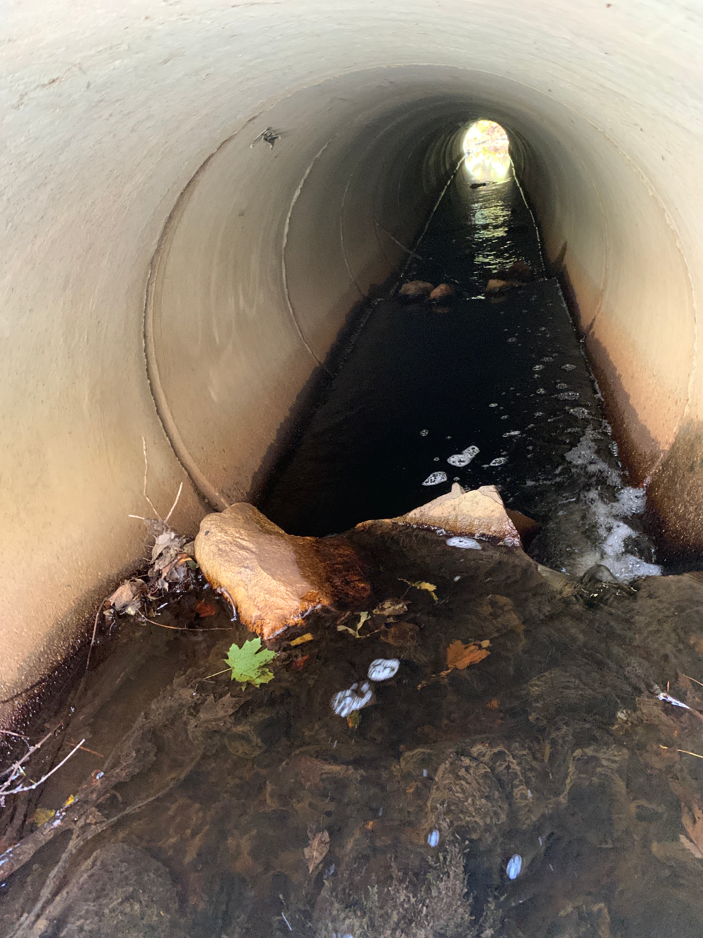
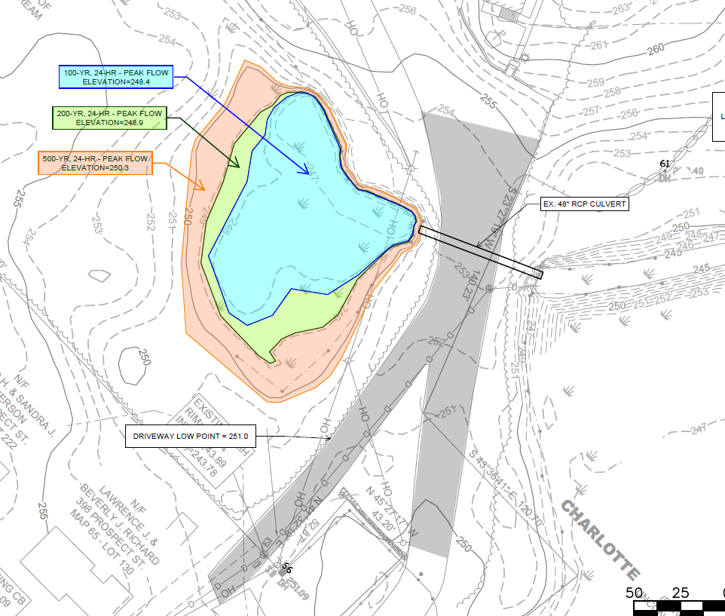
Site Design and Permitting
PERMITTING
Conservation Commision-NOI
Wetland Delineation Review
Resource Area and Buffer Zone Impacts
Stormwater Management Review
Runoff Peak Rate Mitigation
Water Quality
Groundwater Recharge
Culvert Evaluation
Planning Board - Full Site Plan Review
Building, parking layout
Access and circulation
Site grading
Stormwater Management
Utility connections/services
Landscaping/lighting design

Slide 18
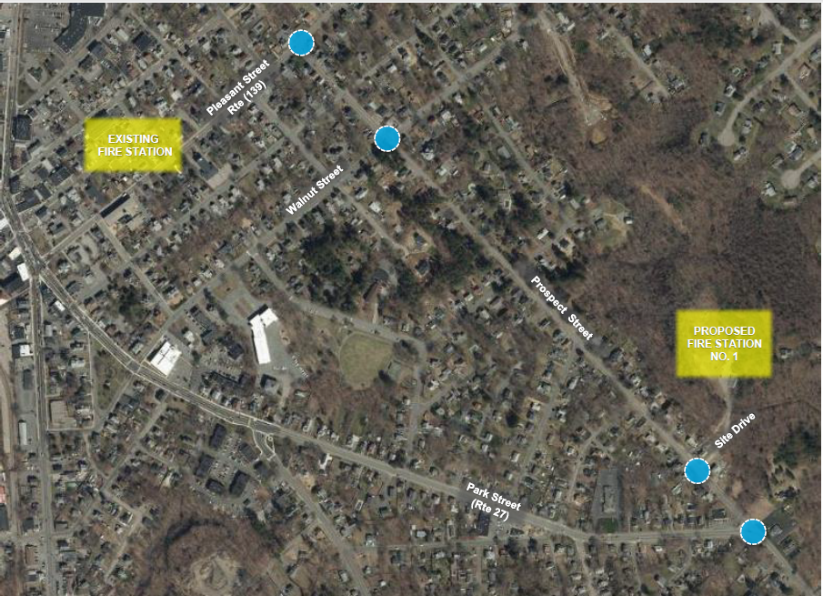

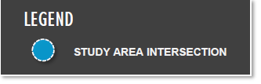
Traffic Mitigation

Slide 19
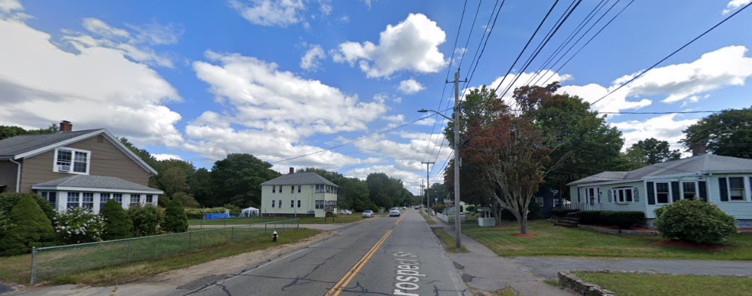
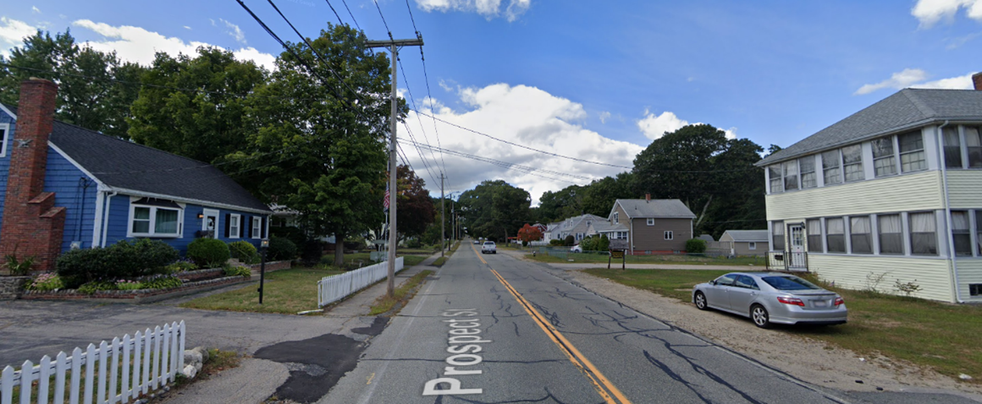
Traffic Mitigation
Prospect Street
Looking South
Prospect Street
Looking North

Slide 20
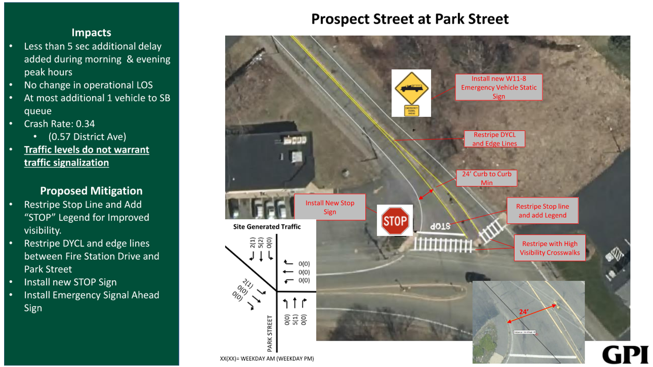
Traffic Mitigation

Slide 21
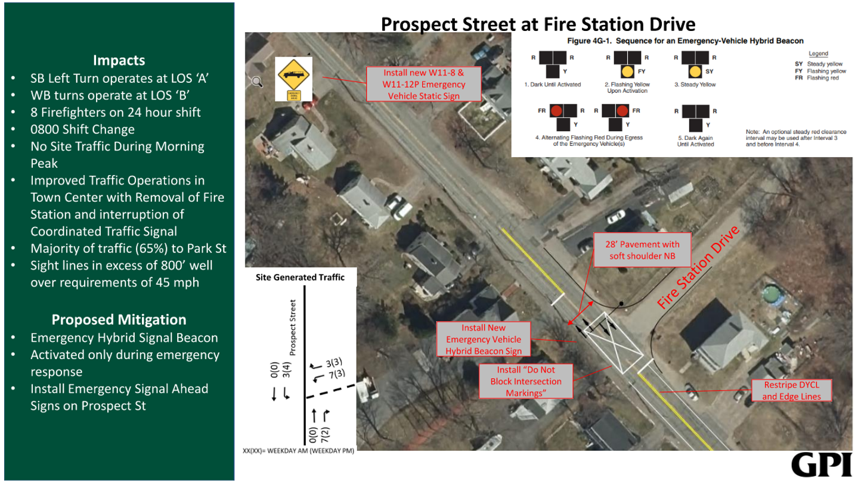
Traffic Mitigation

Slide 22
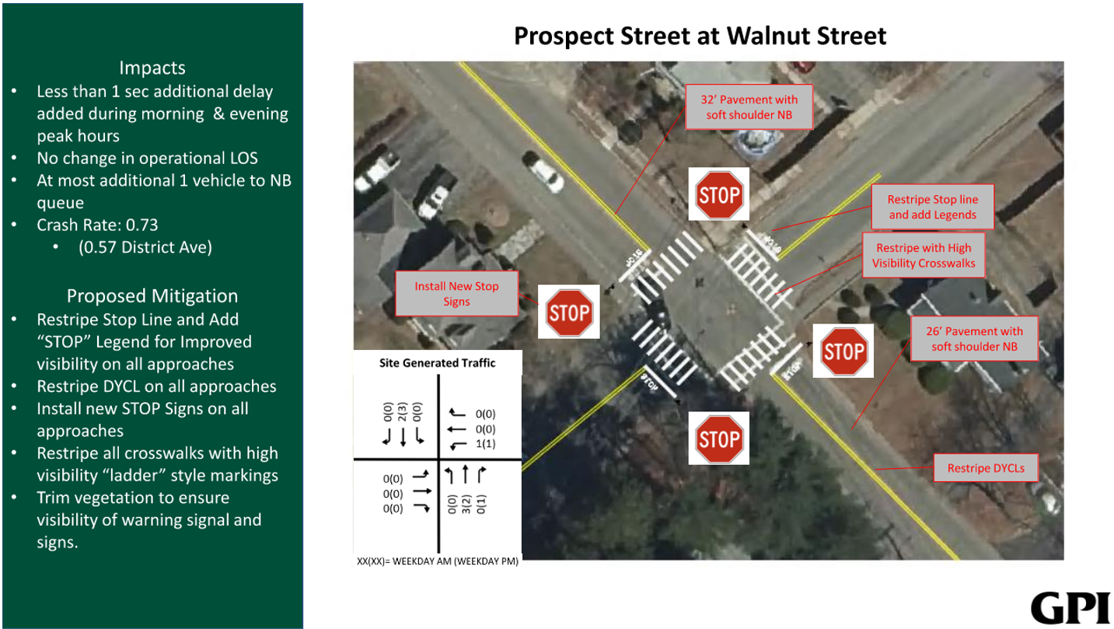
Traffic Mitigation

Slide 23
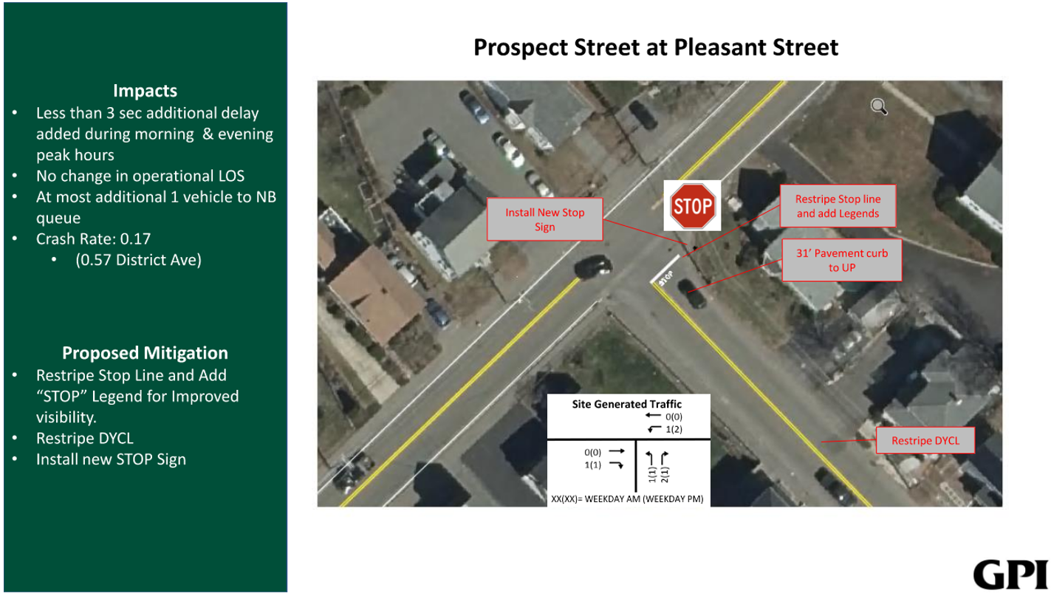
Traffic Mitigation

Slide 24
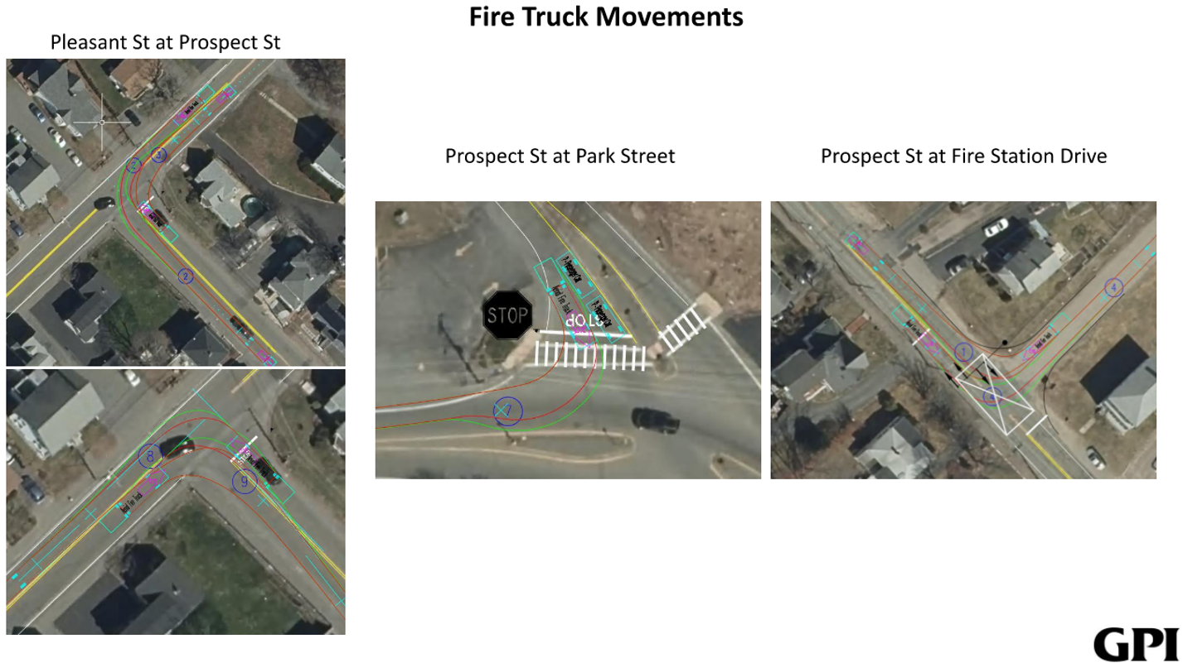
Traffic Mitigation

Slide 25
Rodent Control
Rodent controls were initiated at the site prior to building demolition to control the natural population of rodents.
The rodent control program will continue throughout construction and will be monitored and adjusted as needed.

Slide 26
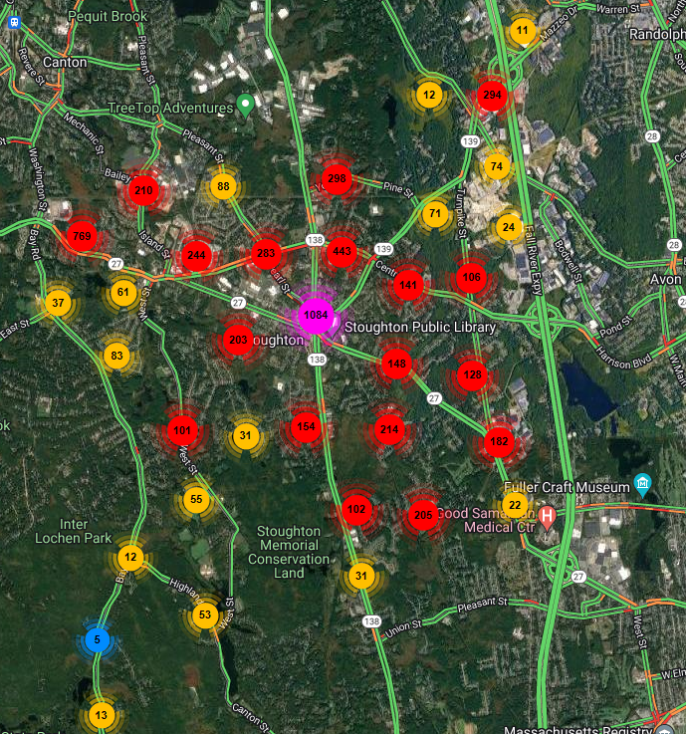
EMERGENCY RESPONSE PERSPECTIVE
Heat Map
Emergency Calls over 5 years
Placement of station- Strategy
Running routes and response times
Increase of 1200 Emergency Calls since 2020
2020- Emergency Response 5259 calls
2021- Emergency Response 5892 calls (12% increase from 2020)
2022- Emergency Response 6452 calls ( 22% increase from 2020)

Slide 27
FIRE CHIEF
Life preservation is our Priority
Current Operations
Future Operations
Station 1 | Station 2
Freeman St | Central St
Engine1, Ladder, 2 Amb | Engine 2
Station 1 | Station 2 | Headquarters
400 Prospect St | Central St | Freeman St
Engine1,Ladder Ambulance | Engine2, Ladder, Ambulance | Administration Emergency Ops DPH

Slide 28
EMERGENCY RESPONSE PERSPECTIVE
Prospect Street/Simple Structure
Operational only Fire Station
Solid Construction and Mechanics
Fill the Fire Department current and
Future needs
Fiscally responsible to the Community

Slide 29
Dore & Whittier Architects - Building & Design
Utilitarian design with durable, long lasting materials
Separates ‘Hot Zones’ from living quarters per fire station design best practices and NFPA guidelines
‘Right Sized’ from exhaustive space needs analysis
10% Room for growth

Slide 30
Pomroy Associates - OPM - Project & Schedule Update
Budget and Bidding Update
Schedule Review
Next Steps

Slide 31
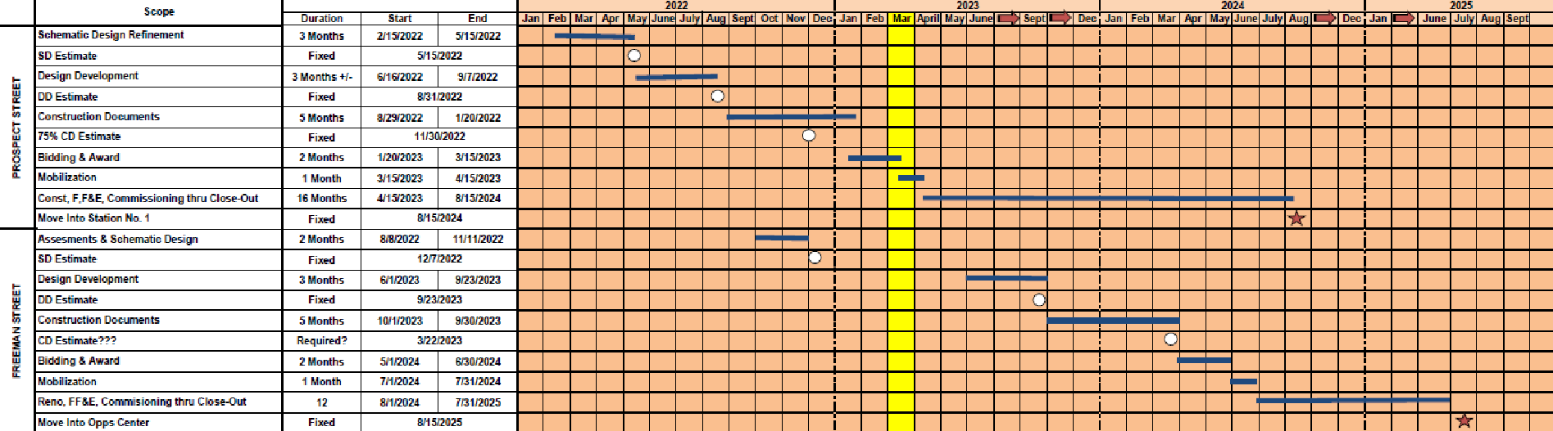
POMROY ASSOCIATES OWNER’S PROJECT MANAGER
Schedule & Budget Update
Both Projects on Schedule which was established Late 2021

Slide 32
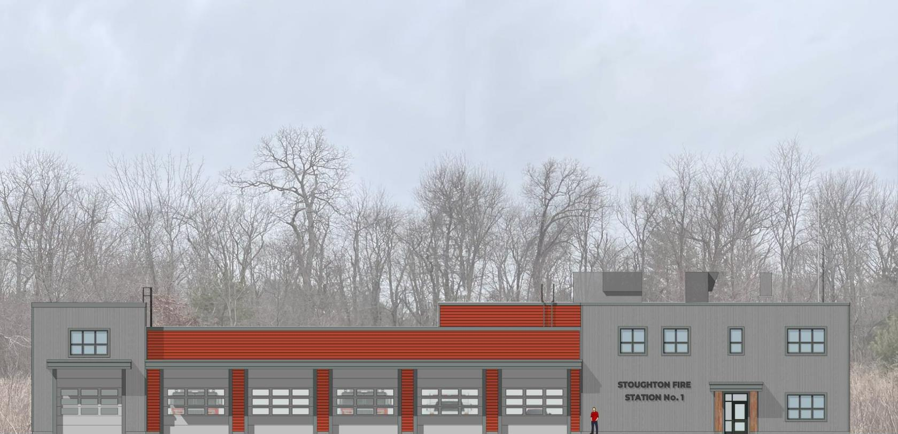
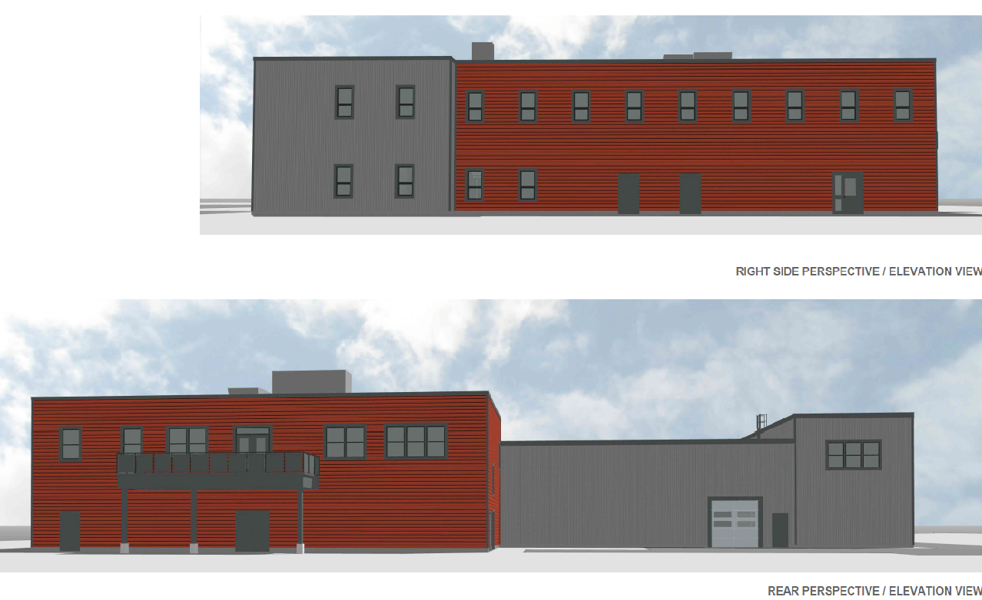
Bidding Results
400 Prospect Street - Bids Received 3/8/23
Current Bidding Climate
5 Bids received
CTA Construction Inc - Low Bidder. The current budget estimate for construction was $19,324,060. CTA’s bid of $17,830,000.00 is 7.7% below the construction estimate and a savings of $1,494,060.00
Bid Results 3/8/23 Comments/Notes
$22,549,655.00 (1) Prospect St - CTA Bid Budget
$8,496,986.43 (2) Freeman St - SD Estimate
$190,000.00 Ramco Bid and award - Demo
$31,236,641.43 Sub Total
$1,150,000.00 Land Acquisition
$32,386,641.43 Total
Town Approved
$27,300,000.00
ARPA Funds
$6,400,000.00
Total Funding Available
$33,700,000.00

Slide 33
Public Engagement - Town Manager Tom Calter
Public Meetings
Public Safety Building Committee Dissolved 6/1/2021
9 Selectboard Meetings 07/06/2021 - 03/14/2023
4 Planning Board Meetings
2 Conservation Committee Meetings
1 Intergovernmental Relations Meeting
1 Municipal Operations Meeting
1 Finance Committee Meeting
Oct 19, 21 Open House Fire Prevention Week
*OPM at Freeman Street available for discussions on the project
Nov 10, 21 - Site Visit at 400 Prospect St
Nov 16, 21 - Site Visit at 400 Prospect st
Nov 18, 2021 Special Zoom Session to Discuss Financing
Open Door Policy from beginning to end - Correspondence from Team to residents -The Team provided contact information including cell phone numbers to any resident to provide information on project

Slide 34
Public Engagement - Town Manager Tom Calter
Election Results
Selectboard passed 5-yes 0-no
*Intergovernmental passed 6-yes 1-no
Municipal Operations passed 5-yes 0-no
Conservation Commission passed 7 yes 0-no
Planning Board On agenda for March 23
*Finance Committee Failed 2-12-1
*The Finance Committee voted 15-0 to add this note: “The Committee supports the Project Concept but has concerns about the property, funding methods and the bundling of multiple projects in one article”
*Intergovernmental Relations Statement: There are no perfect solutions, but the immediate need of town residents for a fire station outweighs our concerns regarding financing.

Slide 35
Public Engagement - Town Manager Tom Calter
Town Meeting Vote
Election Results
Town Meeting Vote December 8th, 2022
Article 1 as AMENDED passed
104/yes 26/no 2/abstain
Election Results February 1, 2022
1311/yes 594/no 8.9% Voter Turnout
Past Local Election Results for Voter Turnout comparison
April 5, 2022 Local Election 3.4% Voter Turnout
June 22, 2021 Special Election 5.8% Voter Turnout
April 6, 2021 Local Election 7.5% Voter Turnout

Slide 36
Questions and Answers
Town Manager Facilitates Questions and Answers

