Slide 1
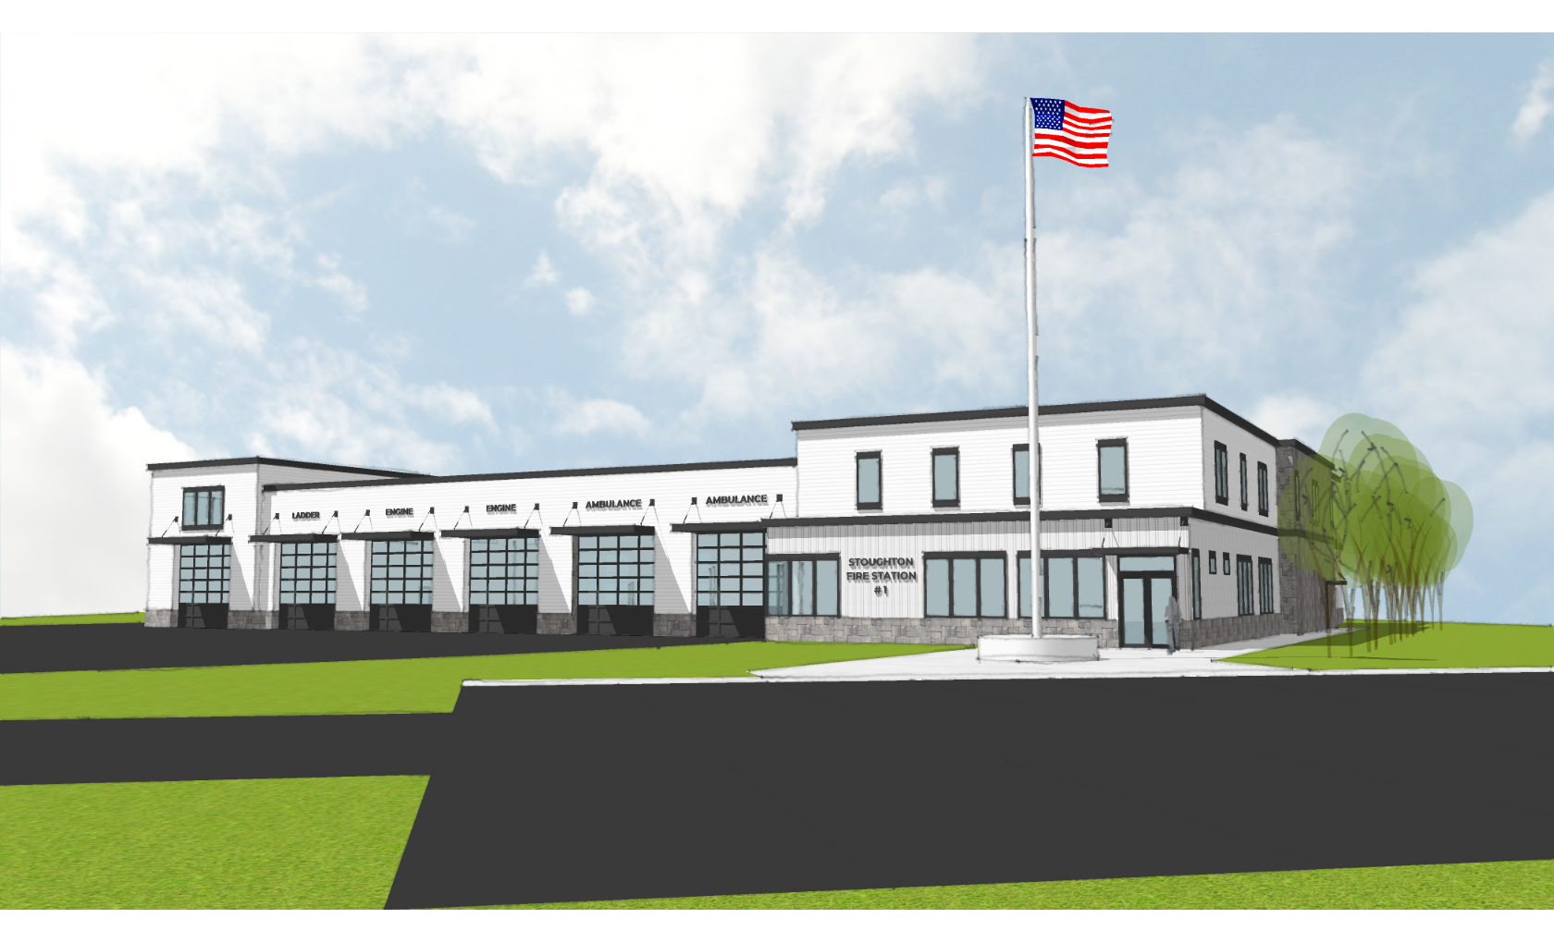
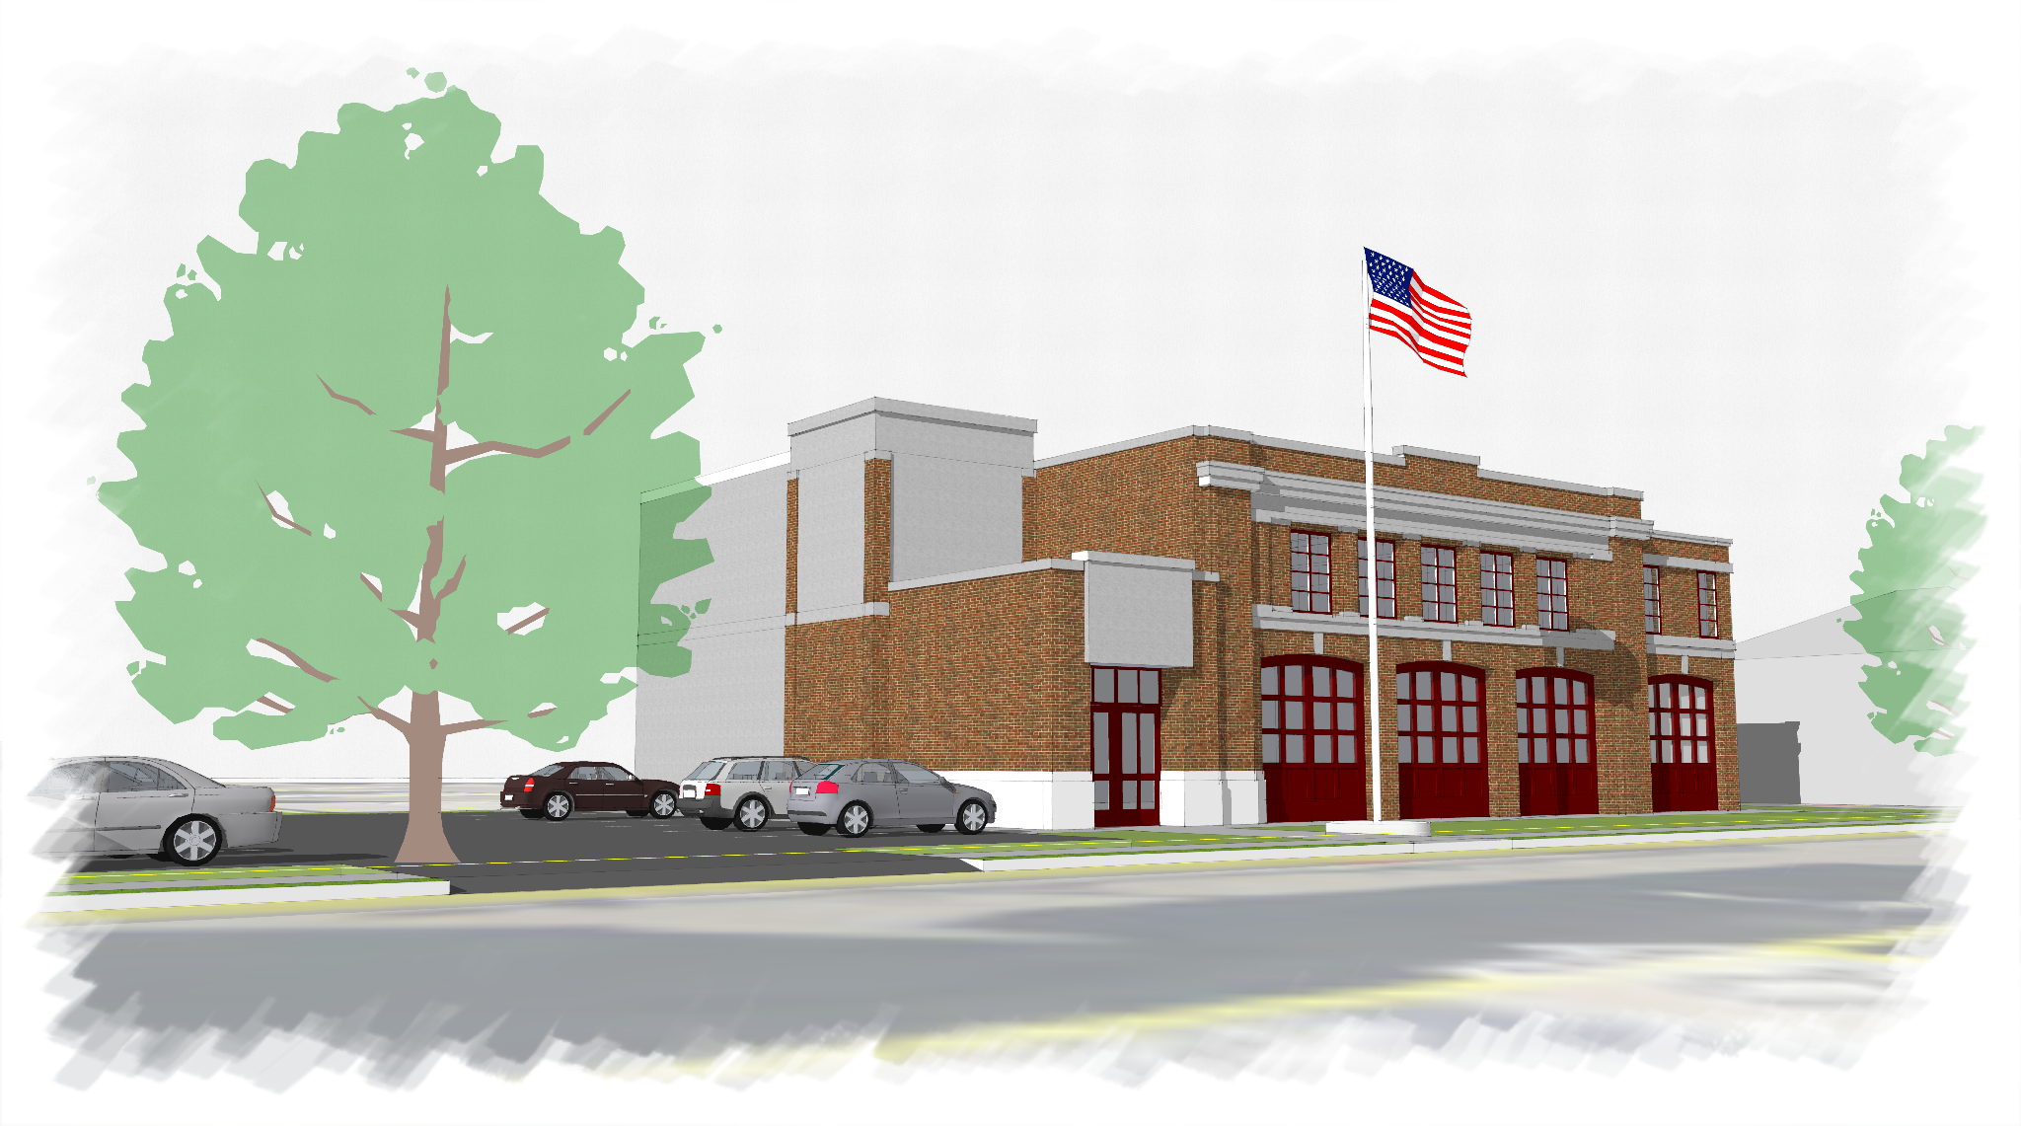
June 28, 2022
STATUS REPORT:
STOUGHTON FIRE DEPARTMENT PROJECT

Slide 2
Fire Department Work Since Town Appropriation
Working Group Meetings
February 17, 2022 – Kick off, establish project schedule, expectations, and milestones. Discussed Architect and OPM Scope for updated proposals.
March 9, 2022 – D&W Proposal reviewed. Floor Plan review. Site updates and Owner Vendor discussions about radios, IT, AV, Security, etc. Early discussions about site plan permitting.
March 22, 2022 – D&W and PA proposals final review. Design update with room data sheets, updated site plans, and kitchen layouts. Geotechnical proposals being received.
April 6, 2022 – D&W and PA proposals signed. Design update with exterior 3D model, HVAC systems discussion, Update on site proposals for Geotech and Haz-mat. Budget reviewed for both Prospect St and Freeman St. IT Meeting with GGD followed the meeting.
April 27, 2022 – Discussed Niche site plan permitting scope. Update on design documents. UEC chosen to move forward with the haz-mat survey at both buildings. Purchase of Prospect St awarded the night previous by Selectboard. SD package sent out for estimate.
May 4, 2022 – Design update given. UEC proposal approved. Geotech proposal still under review. D&W walked through the decon process in the plans. Invoice tracking sheet reviewed.
May 16, 2022 – Design update provided. SD estimate received but not scrubbed yet, in process of review by team. PES was approved for Geotech. Discussion on central dispatch and budget.
May 31, 2022 – SD estimate received and reviewed. Current economic decisions have raised cost of construction. Discussed budget options. Geotech is underway at Prospect St.
June 16, 2022 – Options for dealing with the rising construction costs were discussed at length.
Specialty Design Meetings
2/14/2022 – Floor Plans detailed walk through & review
3/10/2022 – Room Data Sheets review
3/14/2022 – Site Plan Review
3/16/2022 – Room Data Sheets review
3/20/2022 – Walk through existing facilities (Freeman & Central Streets)
4/6/2022 – Technology & Security meeting with Electrical Engineer
4/13/2022 – Room Data Sheets
4/27/2022 – SD final plans review with SFD at Central Street
5/31/2022 – Site Geotech
6/1/2022 – Interior Design Review
6/13/2022 – Water Main / Fire protection discussion

Slide 3
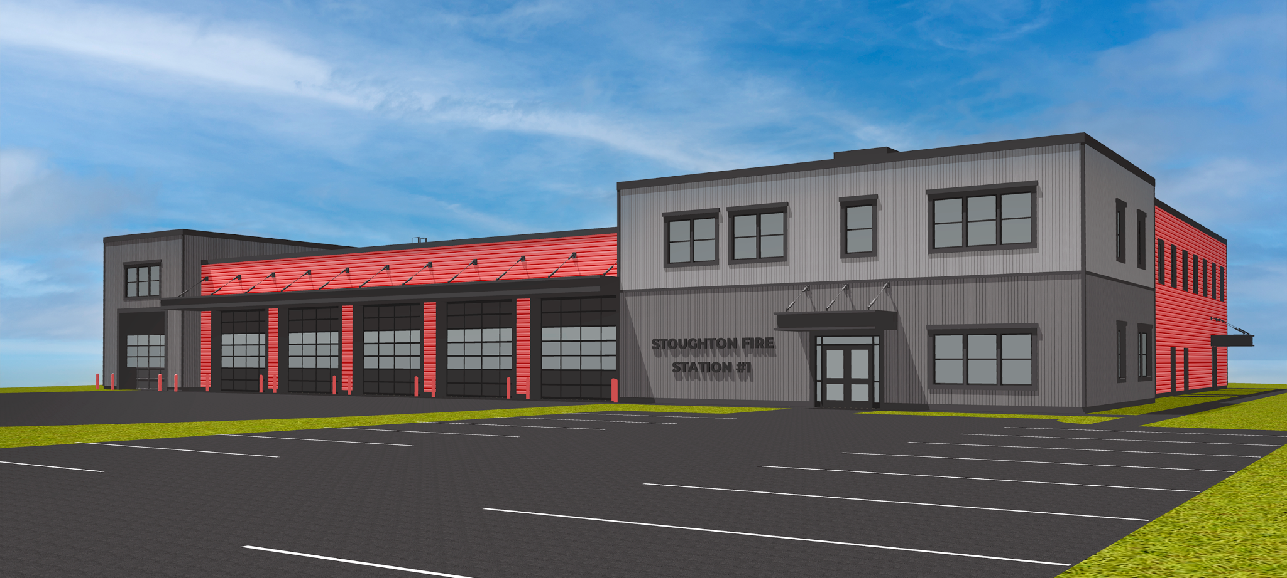
New Total Square Footage @ 25,066 Sq/Ft
Previous Total Square Footage @ 27,200 sq/ft

Slide 4
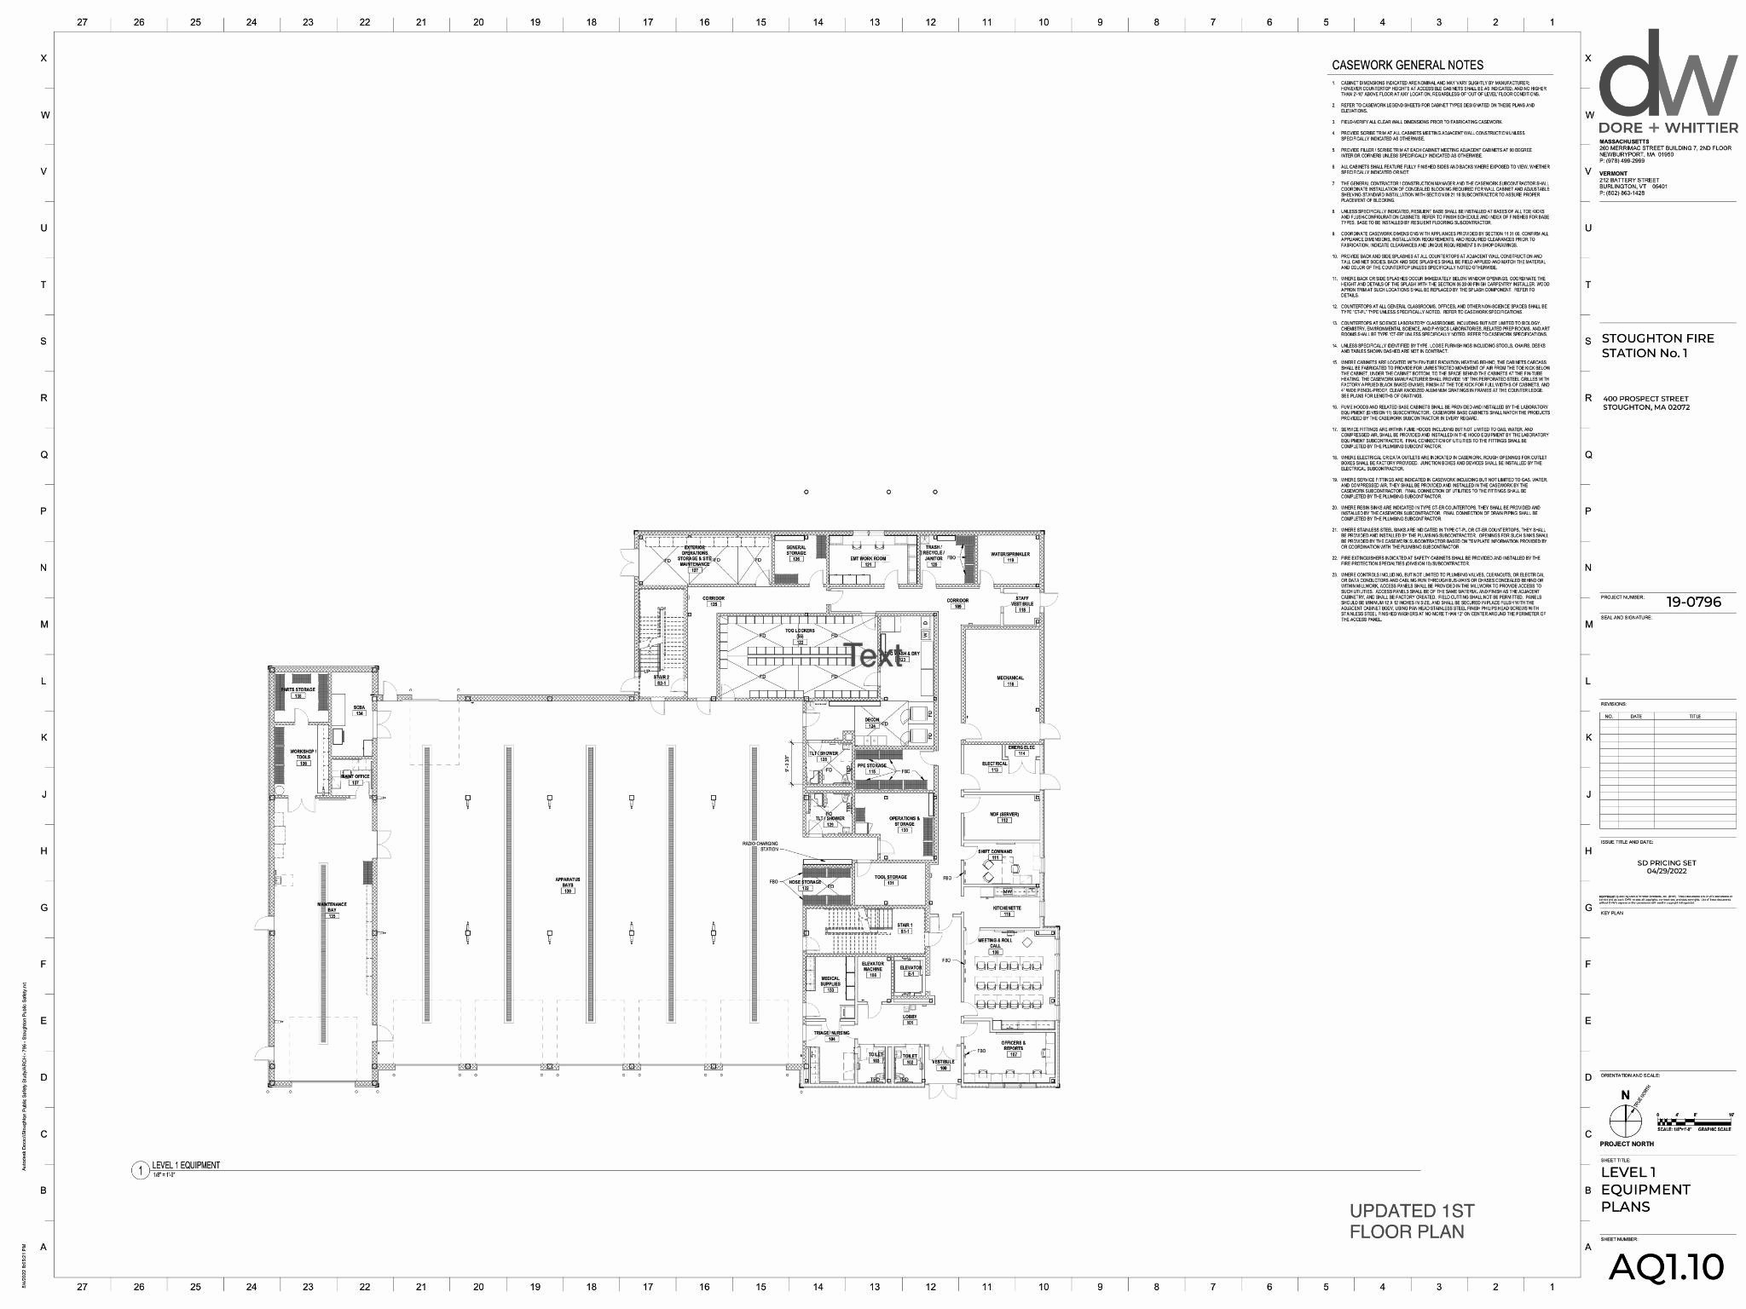
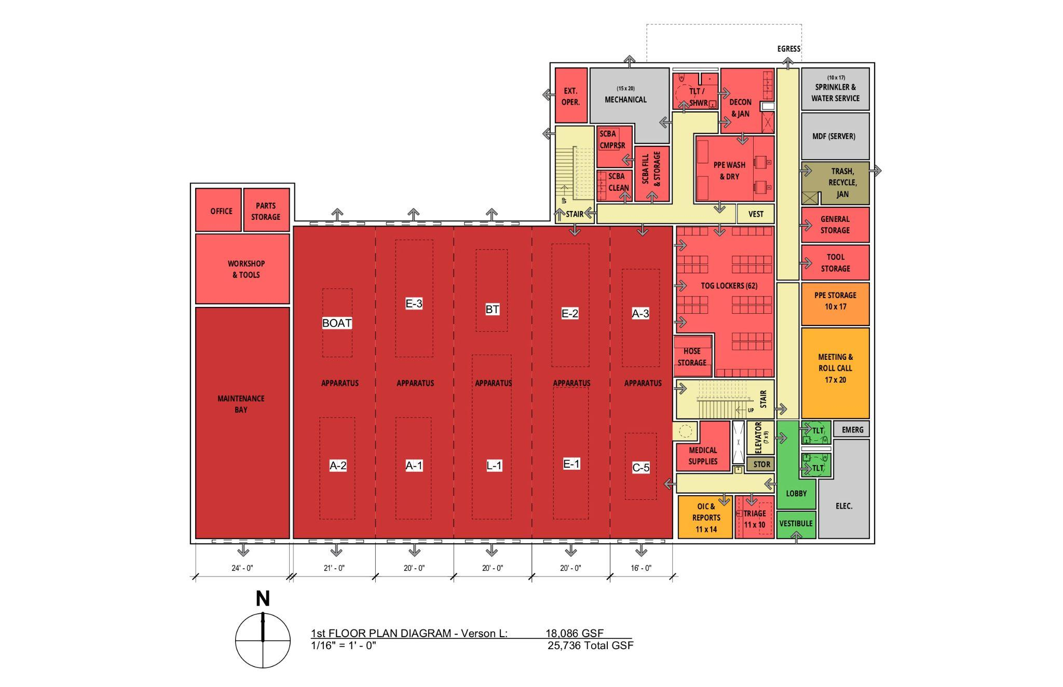
Current design
1st Layout

Slide 5
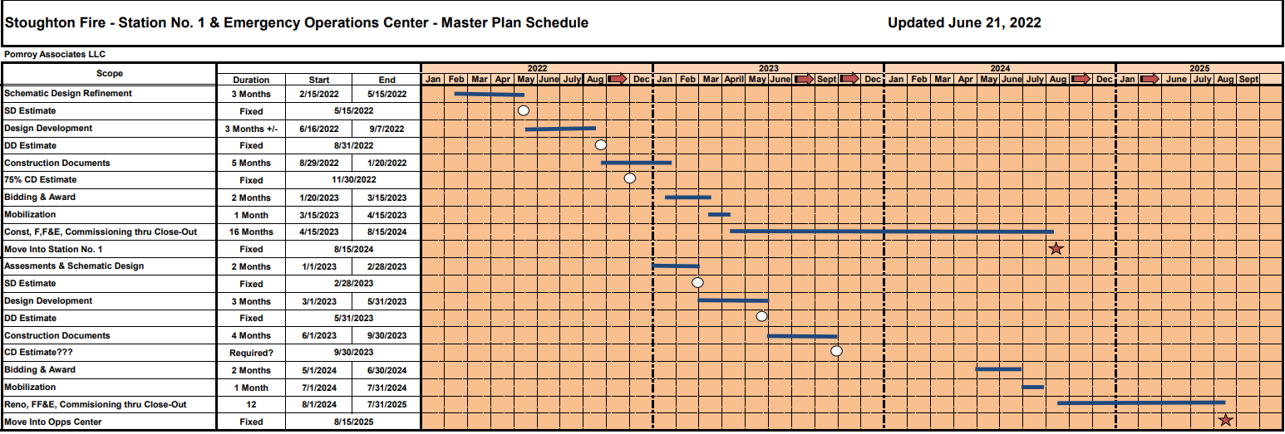
Main Accomplishments
1. OPM and Architect under contract
2. Haz-mat survey and reports for both Prospect and Freeman
3. Geotechnical Investigations completed
4. Re-confirmation of FD Program
5. Room Data Sheets Complete
6. Exterior Modeling Complete
7. Schematic Design Complete
8. Schematic Design Estimate Complete
9. Process of removal of UST underway
10. Stayed on Schedule to this point

Slide 6
Budget Update
Initial Estimated Costs (AUG 2021)
Prospect & Freeman $27,361,000.00
ARPA Funds $6,400,000.00
Net Borrowing $20,961,000.00
Current Estimated Costs (MAY 2022)
Prospect & Freeman $30,365,000.00
ARPA Funds $6,400,000.00
Net Borrowing $23,965,000.00

Slide 7
Next Steps
Approval to Move into the Design Development Phase
Complete Design Development Estimate & Update Budget (AUG 2022)
Selectboard Update (mid SEP 2022)
Projected Bid Start (JAN 2023)
Projected Bid Award (MAR 2023)

Slide 8
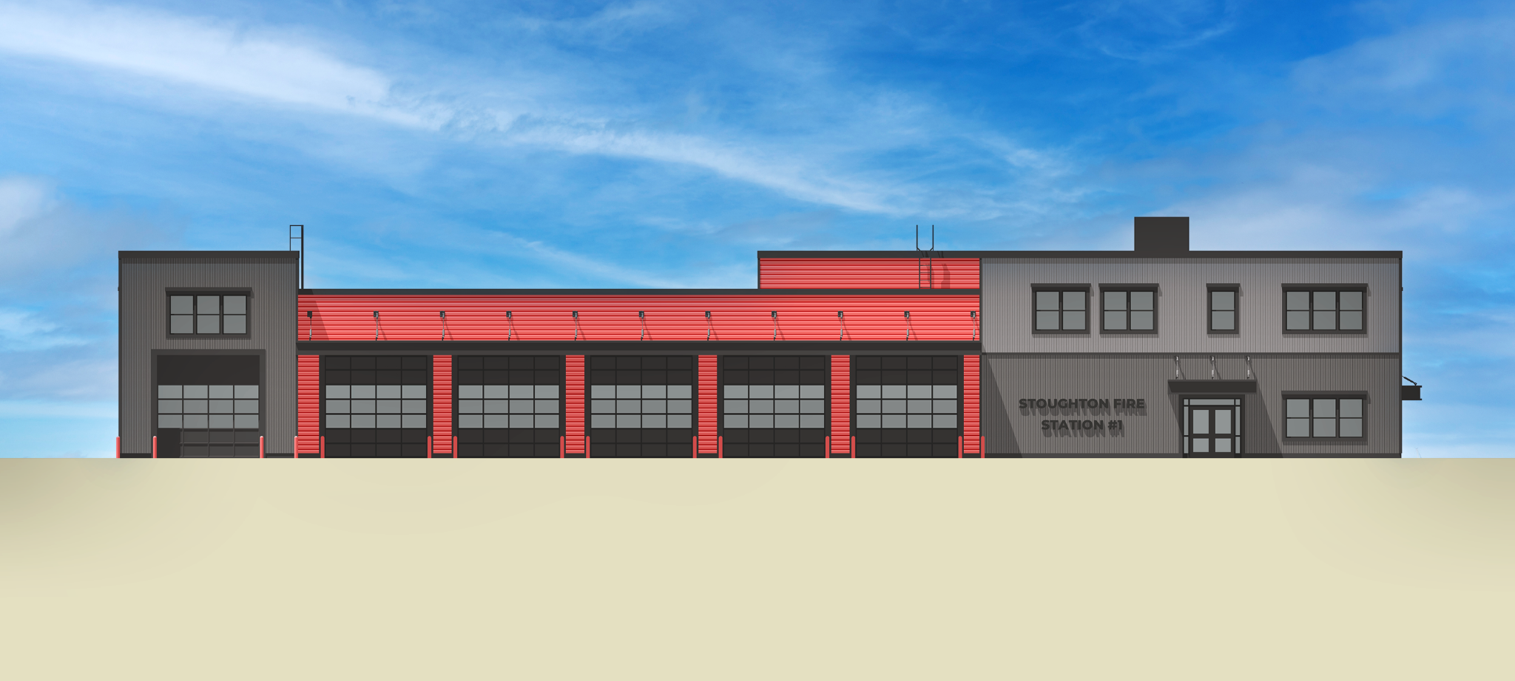
Chief’s Closing Remarks & Open Discussion

